Slide 1
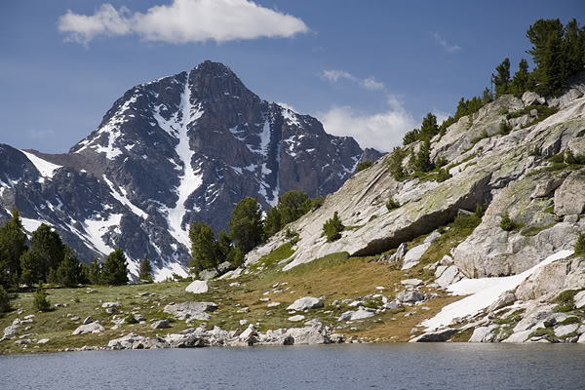
Personality
Chapter 12

Slide 2
Defining Personality
Personality = set of enduring, consistent characteristics within an individual
  The consistent characteristics are “traits”
  “Personality” is therefore the group of traits or a relatively stable approach to situations for an individual
Characteristic patterns of thoughts, feelings, and behaviors that make each person unique

Slide 3
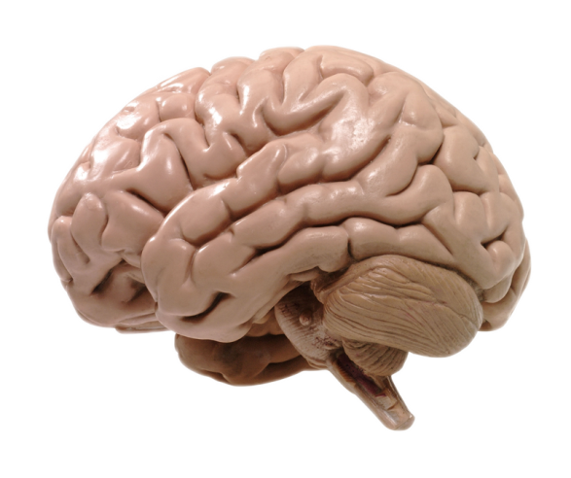
Perspectives on Personality
Personality develops through different “causes”
  1) Psychodynamic
  2) Humanistic
  3) Trait
  4) Life Story
  5) Social Cognitive
  6) Biological

Slide 4
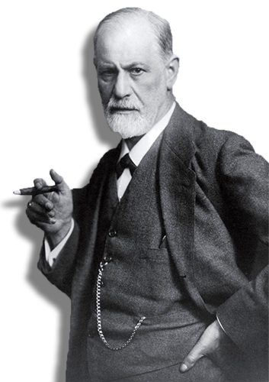
Psychodynamic Perspective
Theoretical view emphasizing that personality is due to the unconscious
Early childhood experiences shape personality in adulthood
Behavior has symbolic meanings (e.g., oral fixation) which are windows to the unconscious

Slide 5
Psychoanalytic Theory
Freud developed Psychoanalysis
  Sex Drive – The drive one has for anything that is pleasurable
  Sex Drive is a determinant of personality development

Slide 6
Psychoanalytic Theory: Background
Hysteria – “Wandering Womb”
  Physical symptoms without physical cause
  Ancient Greeks: A woman’s uterus freely floats within her body; this movement was believed to cause symptoms
  “animal within an animal”

Slide 7
Psychoanalytic Theory
Models his views on the unconscious after this account
“mind within the mind”
Freud: Causes of hysteria must be unconscious

Slide 8
Psychoanalytic Personality Development
Id – “It”
  Unconscious drives
  Pleasure Principle: Seeking immediate gratification
Ego – “I”
  Deals with demands of reality
  Reality Principle: Satisfies the Id within the norms of society
Superego – “Above I”
  “Conscience”
  Mediates the morality of the Id and Ego

Slide 9
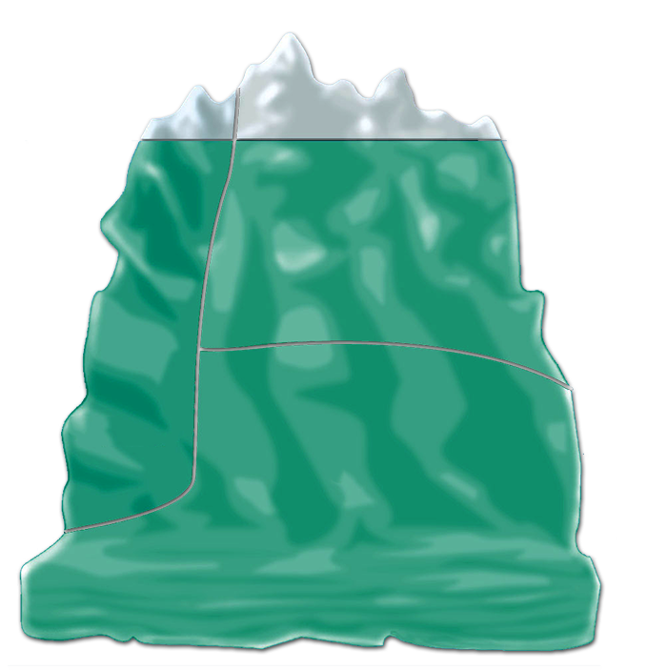
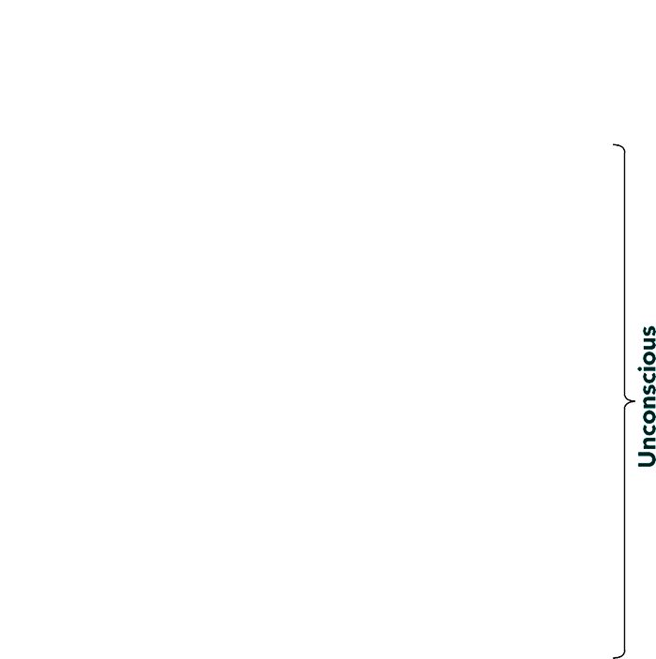

Iceberg Analogy
Ego
Superego
Id
12-9

Slide 10
Defense Mechanisms – Hide the Id!
Repression: Forget the unacceptable
Rationalization: Claim different motive
Displacement: Shift feelings to new object
Sublimation: Transform vile to valuable – painting nudes
Projection: Attribute own faults to others
Reaction Formation: Convert to opposite emotion
Denial: Disbelieve present reality
Regression: Revert to earlier, “safer” period

Slide 11
Defense Mechanisms – Hide the Id!
Example: Ted Haggard
  Evangelical Minister who openly opposed homosexuality
  2006 and 2007, Haggard was found to solicit homosexual prostitutes which he admitted to shortly after
Example: Larry Craig: Idaho Senator (R)
  Vehemently opposed same-sex civil unions/marriage
  Caught soliciting an undercover male prostitute in 2007
Why would someone be so outspoken about the behaviors that they engage in?
What defense mechanism(s) is this?

Slide 12
Psychosexual Stages of Development
Oral Stage: 0-18 months
  Infant’s pleasure focuses on the mouth
Anal Stage: 18-36 months
  Child’s pleasure focuses on eliminative functions
Phallic Stage: 3-6 years
  Focus on the genitals
  Oedipus complex – Boy’s desire to “replace” mother
  Castration anxiety – Boy’s worry about being mutilated by the father

Slide 13
Psychosexual Stages of Development
Latency Stage: 6 years to puberty
  Psychosexual time out
  Sexual urges dormant
Genital Stage: Adolescence to Adulthood
  Sexual reawakening
  Sexual pleasure attributed to another
Fixation
  When one becomes locked in another stage
  “anal retentive” “oral fixation”

Slide 14
Freud: A Controversial Character
Cocaine Addict
  Well… yes for a period
Negative views towards women
  Initially believed only women could get hysteria
  Women were inherently disadvantaged vs. men
Development/Personality driven by sexual desires
  How can prepubescent infants and children have sexual desires?
  Does personality develop so early in life?

Slide 15
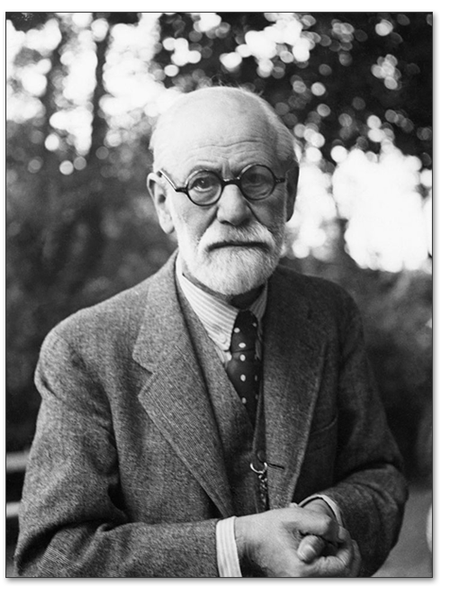
Freud: A Controversial Character
x
Critics:
  Sexuality is not a pervasive force behind personality
  Personality does not develop exclusively early on in life
  Personality development is not restricted to the unconscious
  Personality is driven by sociocultural influence

Slide 16
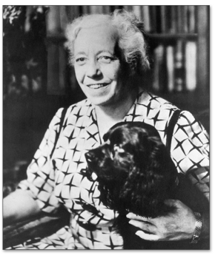
Revolutionists
Karen Horney (“horn-eye”)
(1885-1952)
  Sociocultural approach
  Both men and women envy the attributes of the other
    E.g., Men desire to birth children; Penis envy for women is associated with social power/privilege, not sex
  We have a need for security in early life stages, not sex

Slide 17
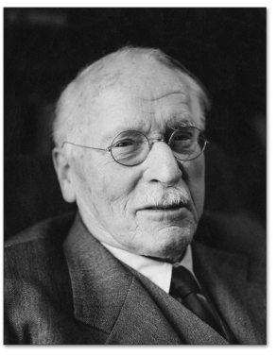
Revolutionists
Carl Jung (1875-1961)
  Collective Unconscious: We share a similar ancestral past that makes an impression on the human mind
  Archetypes: Collective ideas that the unconscious portrays
    Anima - Femininity
    Animus - Masculinity

Slide 18
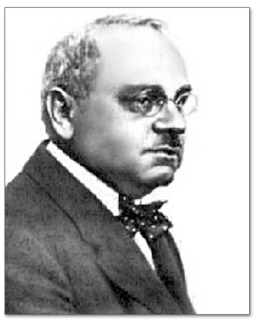
Revolutionists
Alfred Adler (1870-1937)
  Follower of Freud
  Individual Psychology
    People have individual and unique motivations and goals
  Birth Order
    Firstborns: Center of attention, but are replaced
    Middle: Learn from older siblings, advantageous birth order
    Youngest: Spoiled because they are the last, troublemakers

Slide 19
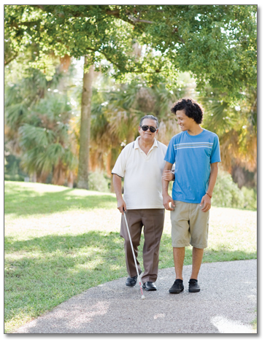
Humanistic Perspective
Emphasis on a person’s capacity for personal growth and positive human qualities

Slide 20
Abraham Maslow (1908-1970)
We can learn a lot about personality by examining those people who are the BEST examples
SELF-ACTUALIZERS!
- Develop one’s full potential as a person
- Few make it to this level (Einstein, Thomas Jefferson, Emerson, etc.)
- Peak experiences: Breathtaking moments of spiritual insight

Slide 21
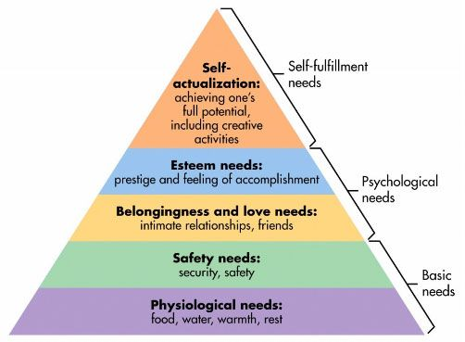
Maslow’s Hierarchy of Needs

Slide 22
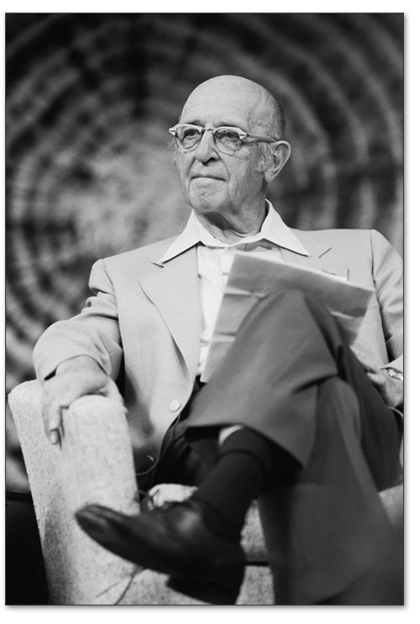
Carl Rogers (1902-1987)
Like Maslow, interested in personal growth
Unconditional Positive Regard
  Everyone should be accepted, valued, and treated positively
  “Benefit of the doubt”
  Empathy
  Genuineness
  Therapeutic benefits
Encourage “optimal functioning”

Slide 23
Evaluating Humanistic Perspectives
Contributions:
  One’s perception of themselves can influence personality (vs. the unconscious)
  Focus on the positives of the self to bring out the positives
Criticisms
  Too optimistic regarding human nature?
  Promotion of self love? Narcissism? Dependence?

Slide 24
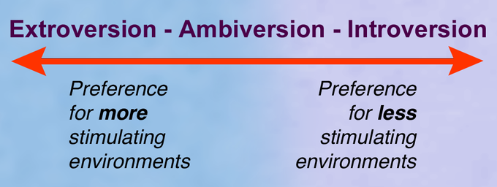
Trait Perspectives
Trait
  Enduring disposition that leads to characteristic responses
  The traits one possesses are how we define “personality” – Trait Theories
Traits operate on a continuum:

Slide 25
Gordon Allport (1897-1967)
Father of Personality Psychology
  Strongly opposed the negativity of Freud
  Agreed with the Humanistic Approach
  Behavior tends to be consistent across situations
  These consistencies can be defined as “traits”
    4500 words in the English language that could be used to describe traits
W. T. Norman: Actually, there might just be 5 traits

Slide 26
Personality Traits
Trait
  Enduring disposition that leads to characteristic responses
  The traits one possesses are how we define “personality” – Trait Theories
Assumed to be stable over time

Slide 27
The Case for Stability: 5-Factor Model
Costa & McCrae (1987) – “Big 5” Traits
  Very commonly used approach to personality
  Traits are independent
  1.) Neuroticism
  2.) Extroversion
  3.) Openness to Experience
  4.) Agreeableness
  5.) Conscientiousness
Think: “OCEAN” or “NEO-AC”

Slide 28
Neuroticism
6 Facets:
  Anxiety, hostility, self-consciousness, depression, impulsiveness, and vulnerability
    High in neuroticism typically means high in all of these traits
  Anxiety/hostility are the basis for fear and anger
  Self-consciousness/depression relate to shame
  Impulsiveness/vulnerability manifest as behaviors

Slide 29
Neuroticism
High in neuroticism typically results in
  Violent or negative emotions
  Difficulty getting along with others
  Ability to deal with life’s problems

Slide 30
Extroversion
3 interpersonal traits
  Warmth, gregariousness (enjoyment of being with others), and assertiveness
3 temperamental traits
  Activity, excitement seeking, and positive emotions
High in extroversion typically results in:
  Keeping busy, preferring stimulating environments
  Preference for social situations and occupations

Slide 31
Openness to Experience
6 facets
  1.) Fantasy: Vivid imagination and active dream life
  2.) Aesthetics: Appreciation of art and beauty
  3.) Action: Willingness to try something new
  4.) Ideas and Values: Curious and value knowledge for the sake of knowing
  5.) Open-mindedness: Acceptance of difference
  6.) Willingness to think of different possibilities: Avoiding functional fixedness, creativity

Slide 32
Openness to Experience
Related to occupational choice
High in openness
  Tend to be intelligent
  Tend to place themselves in high stress environments
  Tend to obtain advanced degrees

Slide 33
Agreeableness
Opposite of antagonism
If low
  Tendency to set themselves against others
  Skeptical
  Mistrustful
  Callous
  Unsympathetic
  Stubborn
  Rude
Scoring high is not a good thing either…
  Individual may be overly dependent on others

Slide 34
Conscientiousness
Includes traits such as:
  Hardworking
  Ambitious
  Energetic
  Persevering
  Punctual
A strong desire to make something of themselves
Positively correlated with
  Cognitive abilities: Working memory and attentional control

Slide 35
How do we assess personality traits?
Self-report!
  Usually via questionnaires
  Many items assessing the same thing (usually just rephrased)
  Looking for common patterns of responding
Problems with self-report?

Slide 36
Big 5 Personality Inventory
This questionnaire contains 15 statements that may or may not describe you. Read each statement carefully. For each one, rate the response that best fits your opinion about yourself.
1 = Strongly Disagree
2 = Disagree
3 = Neutral
4 = Agree
5 = Strongly Agree

Slide 37
1 = Strongly Disagree Through
5 = Strongly Agree
1.) I am not a worrier.
2.) I like to have a lot of people around me.
3.) I don’t like to waste my time daydreaming.
4.) I try to be courteous to everyone I meet.
5.) I keep my belongings neat and clean.

Slide 38
1 = Strongly Disagree Through
5 = Strongly Agree
6.) I often feel inferior to others.
7.) I laugh easily.
8.) Once I find the right way to do something, I stick to it.
9.) I often get into arguments with my family and co-workers
10.) I’m pretty good about pacing myself so as to get things done on time.

Slide 39
1 = Strongly Disagree Through
5 = Strongly Agree
11.) When I’m under a great deal of stress, sometimes I feel like I’m going to pieces.
12.) I am not especially “light-hearted.”
13.) I am intrigued by the patterns I find in art and nature.
14.) Some people think I am selfish and egotistical.
15.) I am not a very methodical person.

Slide 40
Scoring
Reverse Scored Items = 1, 3, 8, 9, 14, 15
If you originally entered in a 1, it would be a 5
  a 2 would be a 4
  a 4 would be a 2
  a 5 would be a 1

Slide 41
Scoring
Now, add up the questions for each personality factor
Neuroticism: Average Questions 1, 6, 11
Extraversion: Average Questions 2, 7, 12
Openness: Average Questions 3, 8, 13
Agreeableness: Average Questions 4, 9, 14
Conscientiousness: Average Questions 5, 10, 15

Slide 42
Averages
Participant sample: 48 younger adults (18-23 years of age)
Neuroticism: M = 2.98; SD = 1.09
Extraversion: M = 3.29; SD = 1.08
Openness: M = 3.03; SD = 0.90
Agreeableness: M = 4.06; SD = 0.88
Conscientiousness: M = 3.63; SD = 1.01
Higher scores mean MORE of a personality factor

Slide 43
Big 5 (Costa & McCrae, 1987)
Argue that personality traits no longer change after age 30
Research shows that these 5 dimensions can be relatively stable over time (30+ years) and across age groups (20-90 years of age)

Slide 44
Big 5 (Costa & McCrae, 1987)
These personality traits appear to occur cross-culturally
  What differs is the extremes on the continuum
  E.g., Eastern cultures do typically show as many high extraversion people
Some evidence that personality factors show up in animals!
  Dogs: Outgoingness (extraversion/openness)

Slide 45
Are they really Independent Traits?
No
Extraversion is positively correlated with openness and agreeableness
Conscientiousness and Neuroticism are negatively correlated

Slide 46
Many other different types of traits…
HEXACO Model (Ashton & Lee, 2018)
  Adds honesty/humility to the Big-5
“Dark Triad” of personality

Slide 47
The “Dark Triad” of Personality
Not all personality characteristics are advantageous
  Socially undesirable, malevolent qualities
Machiavellianism
  Manipulation/exploitation of others without morality
Psychopathy
  Antisocial behavior including impulsivity and lack of emotion
Narcissism
  Lack of empathy for others, self-focus, prideful, egotistical

Slide 48
Evaluating Trait Perspectives
Contributions
  Traits appear to be somewhat independent
  Everyone is on a continuum
  Traits are easy to describe and communicate to others
  Traits related to behavioral effects (career choices, probability of getting married, having kids, etc.)
Criticisms
  Somewhat independent ≠ independent
  Emphasis is not on the situation the behavior occurs in
  Other traits may be available that are not actually measured
    E.g., Honesty/Humility (Ashton & Lee, 2008)

Slide 49
Life Story Perspectives
Hypothetical: If you have 2 people with the exact same traits, would they be the same person?
Personology (Henry Murray) – The study of one’s life history or life story
  Psychobiography: One’s psychological history and its relationship to personality

Slide 50
Social Cognitive Perspectives
Are people consciously aware of their ability to reason, think about the past, present, and future, and reflect on the self?
Examines one’s evaluation of themselves in relation to the environment
  Grounded in behaviorism principles
  E.g., “You act in ______ way during this situation because it has been reinforcing/aversive to you in the past.”

Slide 51
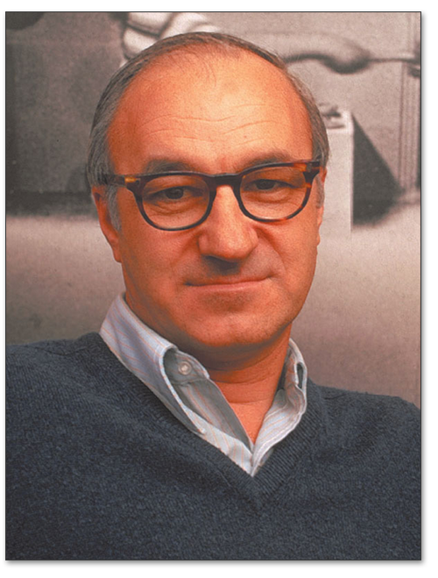
Social Cognitive Perspectives
Albert Bandura (1925-2021)
  Reciprocal Determinism
  The interaction between behavior,
  environment, and cognitive factors
  create personality
Personality tendencies are driven by:
  Observational Learning: How do others behave?
  Personal Control: We can regulate our own behaviors
  Self-Efficacy: Belief in our competency for a given task

Slide 52

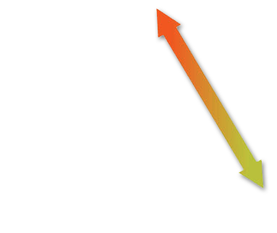
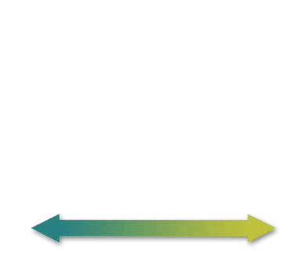
Reciprocal Determinism
Behavior
Person
and cognitive
factors
Environment

Slide 53
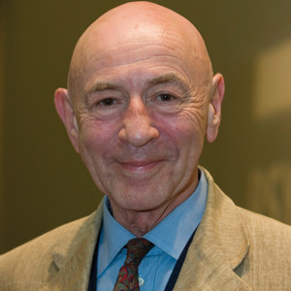
Social Cognitive Perspectives
Walter Mischel (1930-Pres.)
  Situationalism
  Behavior and Personality change as a
  function of context
CAPS Model of personality
  Cognitive Affective Processing Systems
  Personality is the interconnections between emotions and cognitions
  Personality reflects the consistency across time, not the consistency across situations

Slide 54
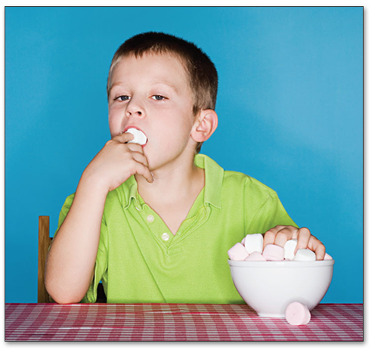
Delay of Gratification
Marshmallow Study
Children were seated in a room by themselves with a single marshmallow on a plate
Told that if they could delay eating the marshmallow for 5 minutes, they could have 2 marshmallows, but if not they could eat it now, and only get 1
Children who delayed eating the marshmallow…
  Were more likely to excel academically in the future
  More likely to obtain high paying jobs and report greater life satisfaction
  Delay of gratification in childhood occurs in adulthood

Slide 55
Evaluating Social Cognitive Perspectives
Contributions
  The environment can effect personality
  People can control their environment (e.g., avoidance) and therefore have an effect on their personality
Criticisms
  Overly concerned about environmental influence?
  Isn’t personality supposed to be more stable?
  Ignores the role of biological effects (tendencies)

Slide 56
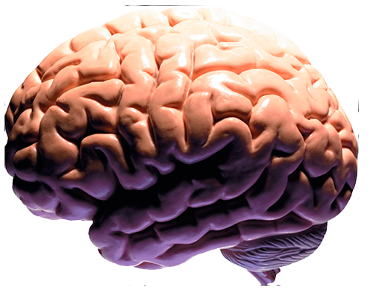
Biological Perspectives
Personality and the Brain
  Brain lesions alter personality (e.g., Phineas Gage)
  Reticular Formation has different baseline activation levels depending on ones personality (Eysenck, 1967)
    Introversion vs. Extraversion
  Gray’s Reinforcement Sensitivity Theory
    Behavioral Approach System – seeks positive consequences, positive demeanor, extraverted
    Behavioral Inhibition System – avoids negative consequences, negative demeanor, intraverted

Slide 57
Biological Perspectives
Neurotransmitters
  High levels of dopamine receptors in warm caregivers
  Sensitive to reward in extraverts
  Less serotonin leads to negative moods and neurotic behaviors

Slide 58
Biological Perspectives
Behavioral Genetics
  Twin studies show lots of genetic effects on the Big 5 personality traits
  Personality traits seem to be affected by multiple genes

Slide 59
Biological Perspectives
Problems with Biological Perspectives
  Chicken/Egg Question
  Does one’s biological systems cause personality?
  Or does one’s personality cause the state of their biological systems?

Slide 60
Personality Assessments
How does one measure these characteristics?
  Allport: 4,500 words
Self-report tests
  Ask subjects whether specific descriptions are accurate of themselves
  MMPI-2: Minnesota Multiphasic Personality Inventory, 567 Items
  NEO-AC Inventory: 100 Items; 60 Shortened version

Slide 61
Personality Assessments
Projective Tests
  Ambiguous stimulus, test taker projects what they think the meaning is
  Rorschach Inkbot Test

Slide 62

Rorschach Test

Slide 63
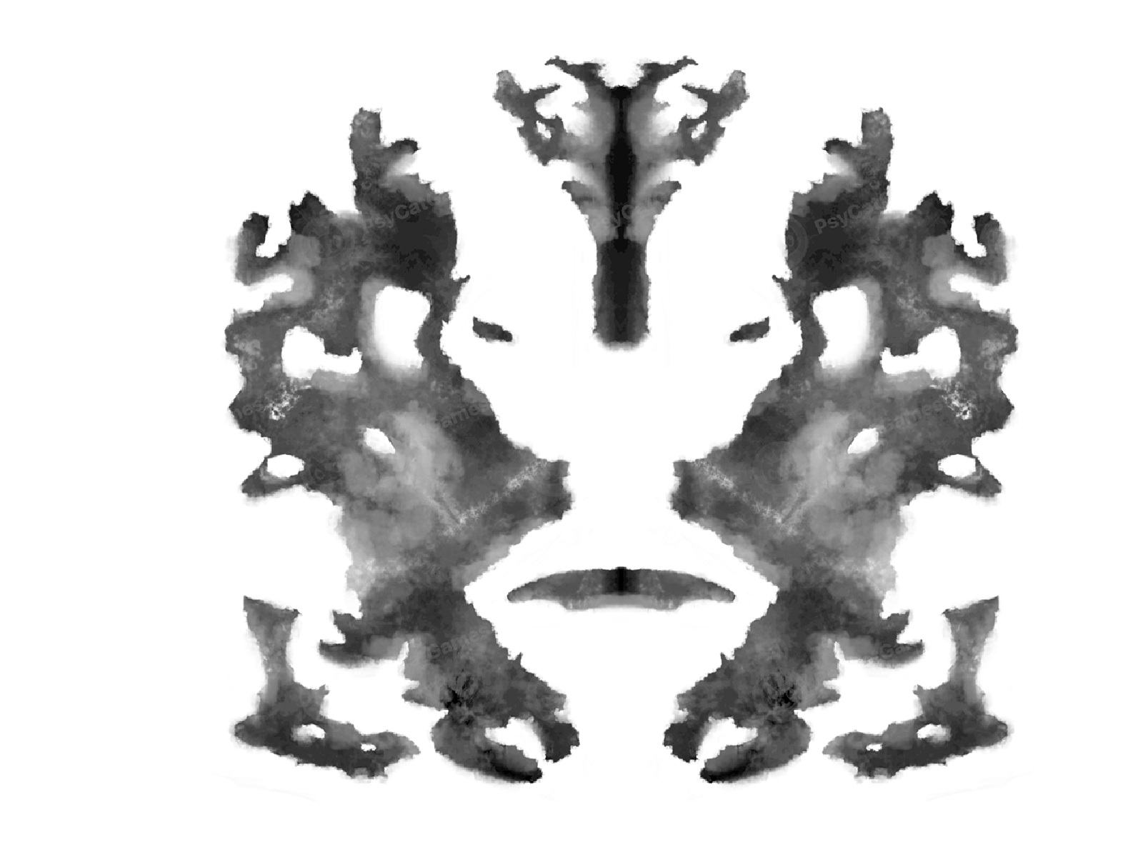
Rorschach Test

Slide 64
Personality Assessments
Thematic Apperception Test (TAT)
  Reveals an individual’s perception of interpersonal relationships
  Individuals view a scene and are asked to tell a dramatic story including:
    What has led up to the event?
    What is currently happening?
    What are the thoughts and feelings of the characters?
    What is the outcome?

Slide 65
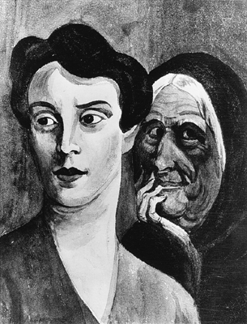
Thematic Apperception Test (TAT)

Slide 66
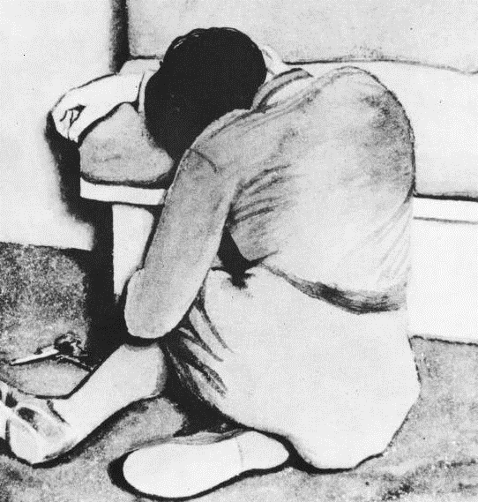
Thematic Apperception Test (TAT)

Slide 67
Personality Assessments
Other Assessments:
  1.) Behavioral Observations
  2.) Cognitive Assessments of Attention and Memory
  3.) Peer Ratings
  4.) Physiological Measures (Galvanic Skin Response)
    GSR: Skin electrical conductance in response to emotional stimuli
  5.) Brain Imaging

Slide 68
Personality is Related to Wellness
Traits correlated with health outcomes
Conscientiousness
Personal Control – Controlling stress during difficult times
Self Efficacy
Optimism
Type A – Increased risk for heart disease
Type B – More positive health outcomes

Slide 69
And Now… Reminders!
Quiz 8 (Personality) (10/30)
Exam 3 (11/1)
  Bring a scantron!

